Slide 1

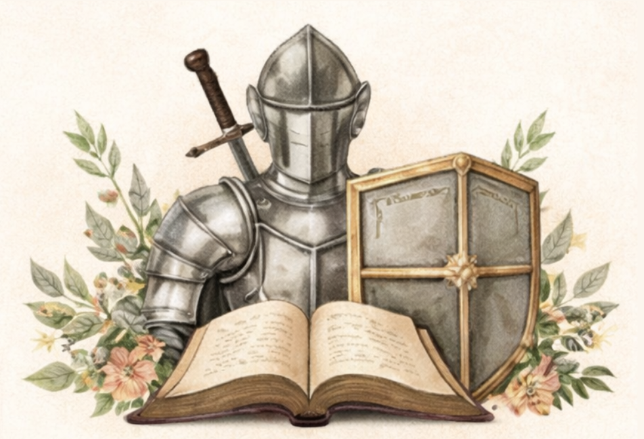
The Armor of God
Standing Firm
Wherefore take unto you the whole armour of God, that ye may be able to withstand in the evil day, and having done all, to stand. Ephesians 6:13
Standing Firm in the Faith |  | 16 | 2 Chronicles 20:17
1 | 1 Corinthians 16:13 | 17 | John 16:33
2 | Philippians 1:27 | Perseverance & Endurance
3 | Philippians 4:1 | 18 | Romans 5:1-2
4 | Colossians 1:23 | 19 | Romans 8:37
5 | Colossians 4:12 | 20 | Galatians 5:1
6 | 2 Thessalonians 2:15 | 21 | 2 Timothy 2:3
God’s Strength Sustains Us |  | 22 | 2 Timothy 4:7-8
7 | 2 Thessalonians 3:3 | 23 | Hebrews 10:23
8 | Isaiah 40:31 | 24 | Hebrews 12:1-2
9 | Isaiah 41:10 | Trusting God Through Every Trial
10 | Psalm 18:2 | 25 | Psalm 27:14
11 | Nahum 1:7 | 26 | Psalm 31:24
12 | Jude 1:24 | 27 | Psalm 46:1-3
Courage in the Battle |  | 28 | Psalm 62:5-8
13 | Joshua 1:9 | 29 | Proverbs 3:5-6
14 | Deuteronomy 31:6 | 30 | James 4:7
15 | Exodus 14:13-14 | 31 | 1 Peter 5:8-9
God’s Word can be understood and heard clearly when it is written out.
Grab your Bible, journal, and some colorful pens, and let’s Journal Scripture together.
You can read the monthly devotional at:
https://charitymaeprosper.com/armor-of-god-standing-firm
Melissa Smith | www.charitymaeprosper.com

